Slide 1

Care Cash Program
[Client Name]
[Program Effective Date]
Notes:
B2B EI243641150.0 11/24 © 2024 United HealthCare Services, Inc. All Rights Reserved.

Slide 2
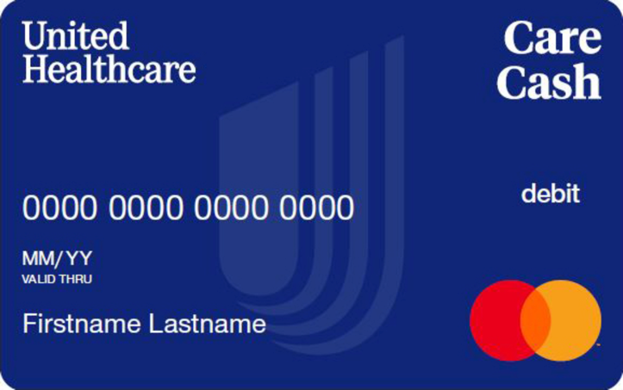
Introducing Care Cash
Member Care | Care Cash
Care Cash® is a preloaded debit card that helps you pay for eligible quality network care expenses.
Included in your health plan, your card comes loaded with $200 for individual or $500 for family plans to utilize throughout the plan year
You can use your Care Cash debit card to help pay for program-eligible network care expenses with UnitedHealthcare network providers in the following categories:
    Primary care providers, UnitedHealth Premium® designated providers, 24/7 Virtual Visit providers, urgent care facility providers, outpatient behavioral health providers and outpatient lab expenses
Save your Care Cash card
    Your unused card balance will roll over each plan year and does
    not expire*
    You can reload your card with new funds each plan year*
Visit myuhc.com/carecash and sign in to request your prepaid debit card
Activate your card upon receipt by calling the toll-free number
Use Care Cash in place of a personal credit card or debit card
*Unused dollars roll over towards a $2,000 maximum. Care Cash medical plan eligibility must be maintained.
Notes:
People sometimes don’t engage with their health because they feel it’s complicated or expensive. Care Cash® is a unique way to engage employees and help them pay for health care expenses.
Employees receive information about Care Cash and can request the card on myuhc.com®. The preloaded debit card they can use for UnitedHealth Premium® primary care and specialist provider visits, as well as network primary care provider visits, 24/7 Virtual Visits, urgent care visits, outpatient behavioral health visits and outpatient lab expenses.
The Care Cash card:
Gives an employee $200 for the year for individual coverage or $500 for family coverage
Is reloadable, with any remaining balance rolling over each year (if Care Cash-eligible medical coverage is maintained)
Care Cash may help drive greater employee health engagement and positive health behaviors to help reduce the total cost of care.

Slide 3
Request your card

Slide 4
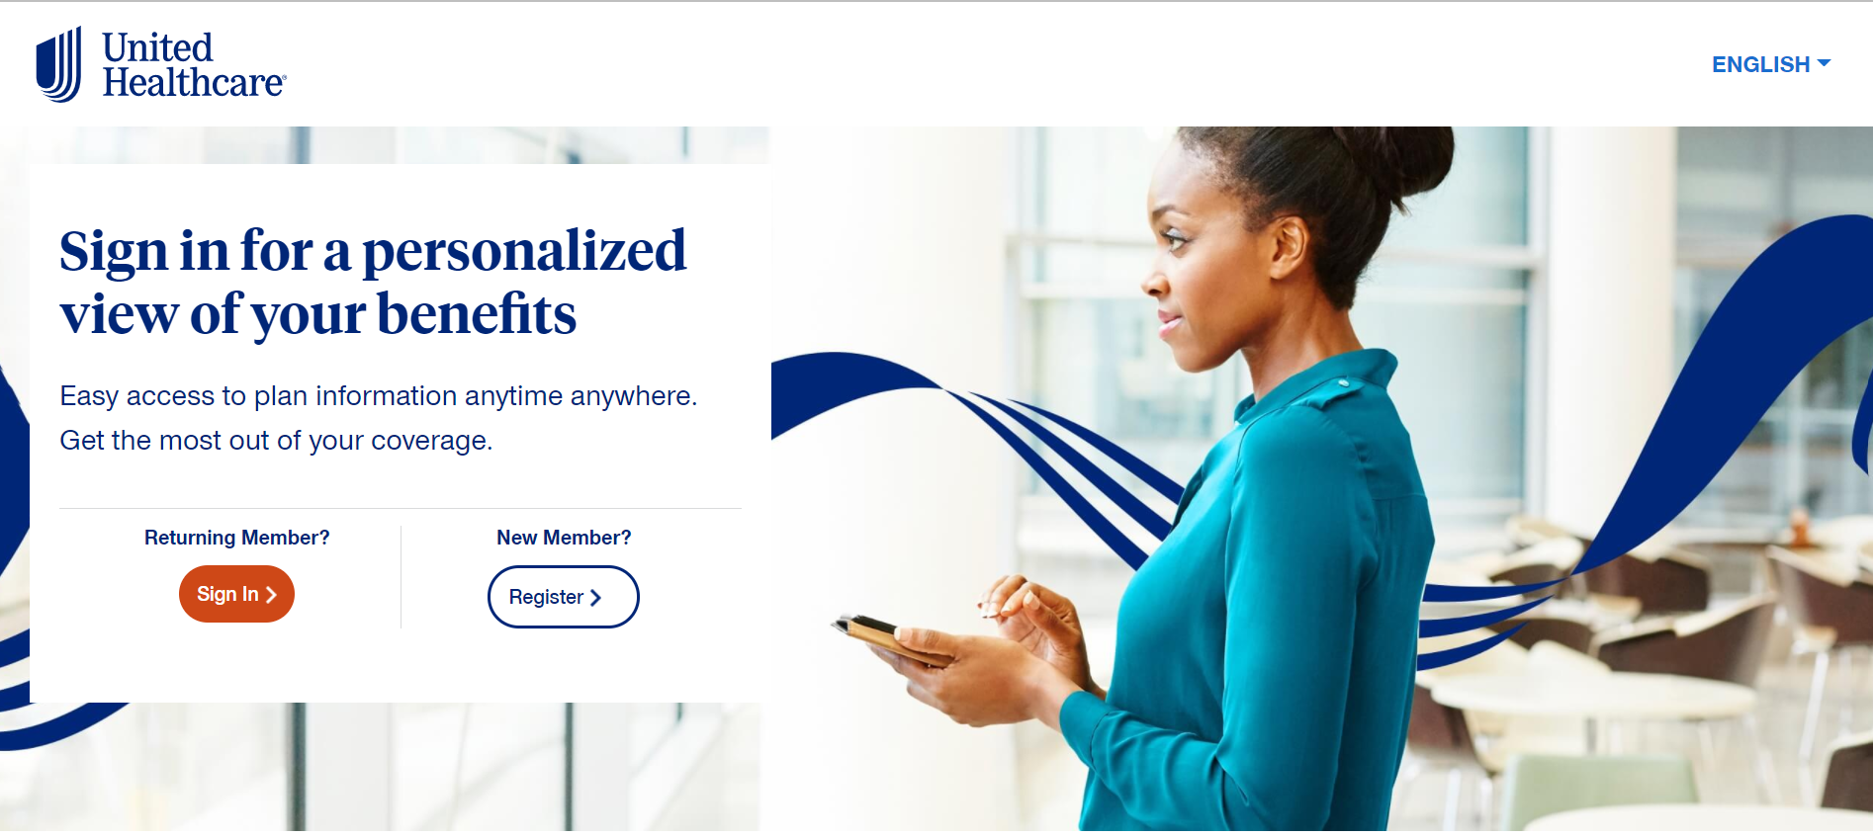
Sign in or register on myuhc.com
Member Care | Care Cash
You must be registered on myuhc.com® to request your Care Cash debit card. Visit myuhc.com/carecash and click Register or click Sign In if you have an existing account.
Notes:
To sign in to your existing account or to request access to your Care Cash card, you must be registered on myuhc.com® to request your Care Cash debit card. Visit myuhc.com/carecash and click Register or click Sign In if you have an existing account.

Slide 5
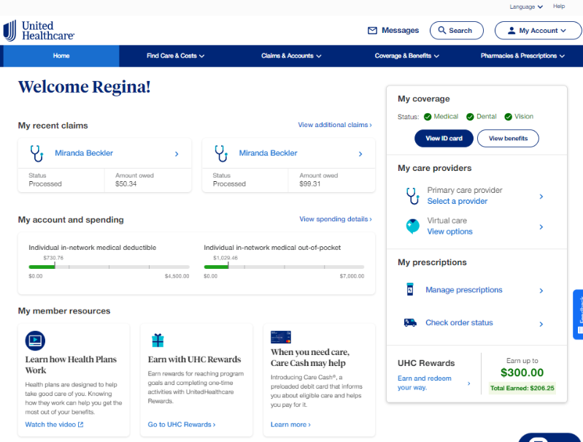
Request the Care Cash card
Member’s view of myuhc.com

Slide 6
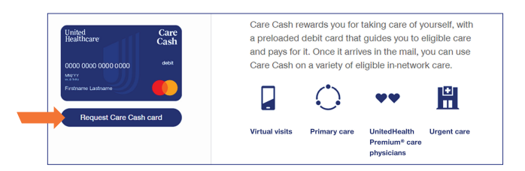
Register for the Care Cash card
Once you’re on the Care Cash page, click the Request Care Cash card button.

Slide 7
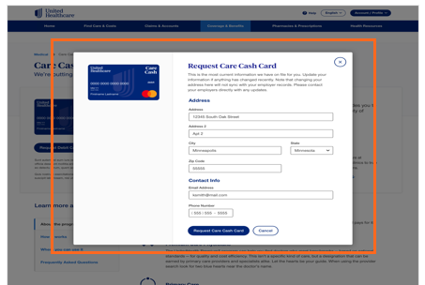
Register for the Care Cash card
Follow the prompts to verify your address and contact info or make any required updates. When you’re finished, click the Request Care Cash card button.

Slide 8
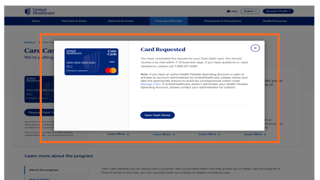
Register for the Care Cash card
A confirmation message will appear to let you know your card has been requested. Your card should arrive by mail within
7–10 business days.

Slide 9
Activate your card
Once you receive your card, you’ll need to activate it by calling the toll-free phone number listed on the card sticker.
To activate your card, call
1-833-573-8144

Slide 10
Find eligible care

Slide 11
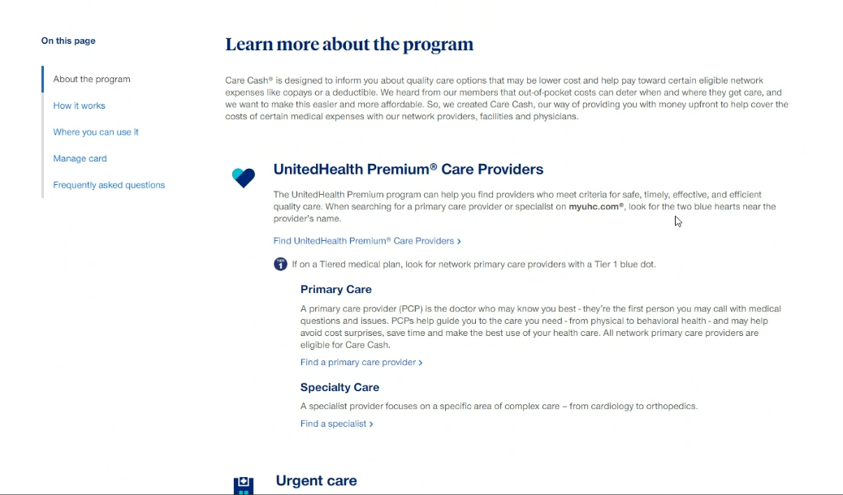
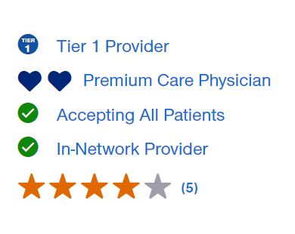
Find eligible providers
Go to myuhc.com/carecash
Click About the Program
Click the link under the specialty
Verify your selected provider has at least one of the following designations: Tier 1 Provider, Premium Care Physician or In-Network Provider

Slide 12
Ineligible services

Slide 13
Ineligible services
Below are examples of services that Care Cash does not cover (not an all-inclusive list):
Inpatient hospital services
Outpatient hospital services
Pharmacy
Network-only specialists
Noncovered services
Radiology services
Dental providers
Vision providers
Services by a Care Cash provider in a hospital setting

Slide 14
Balance and transactions

Slide 15
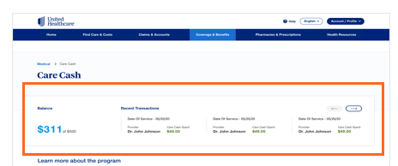
Check balance and recent transactions
Go to myuhc.com > Coverage & Benefits > Select Care Cash
The balance will be adjusted based on card transaction activity
The 5 most recent transactions
will display
Call the toll-free phone number on your health plan ID card to request full transaction details

Slide 16
Card declines

Slide 17
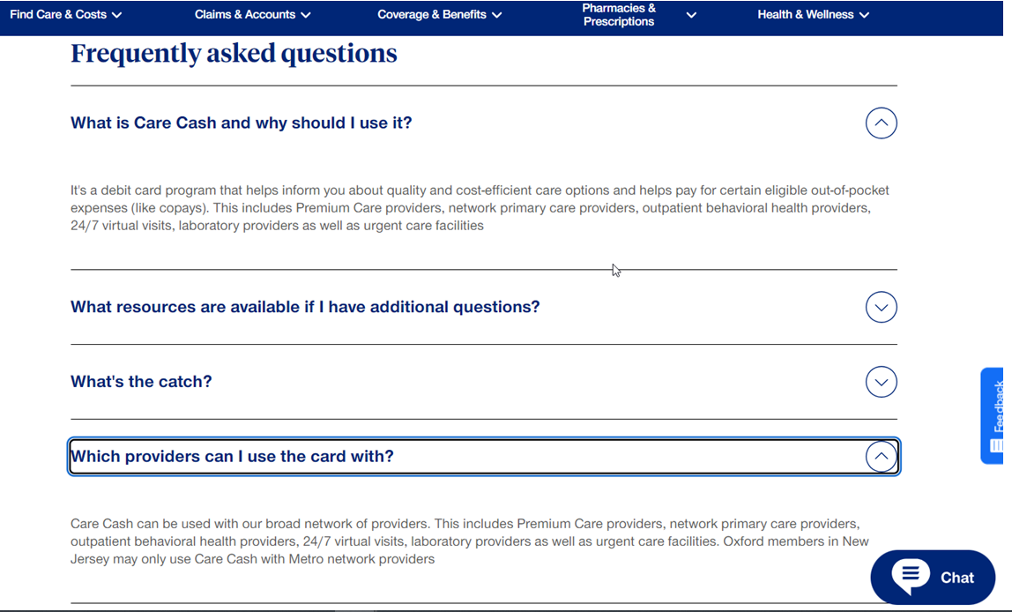
What if my Card declines at a Care Cash provider?
1
Temporarily use an alternate form of payment for your visit and save your receipt.
2
Visit myuhc.com/carecash and start a chat session to upload receipt to update the provider’s profile. (The ‘chat advocate’ appears in the lower right of all screens.)
3
Ask the chat advocate for a link to upload your receipt requesting a review of the provider’s Care Cash profile. You will receive a response in 15-20 business days.
*Care Cash with its Mastercard logo is accepted at all Care Cash-eligible providers who have credit card terminals. It can be run without without the PIN.

Slide 18
Reload your card

Slide 19
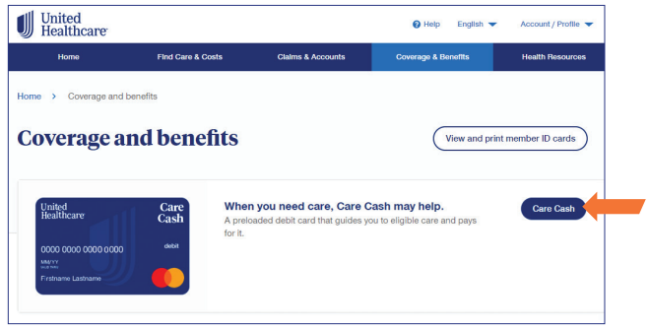
Reload your registered Care Cash card
Every plan anniversary, you are eligible for an additional $200/$500 to the same card. A new card is not sent to you.
Sign in to myuhc.com/carecash
Scroll to the Care Cash section and click the Care Cash button.

Slide 20
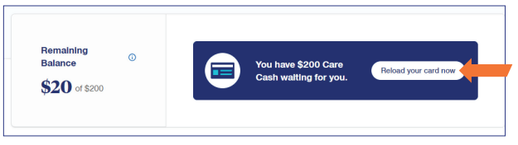
Reload your registered Care Cash card
Once you’re on the Care Cash page, click the Reload your card now button.

Slide 21
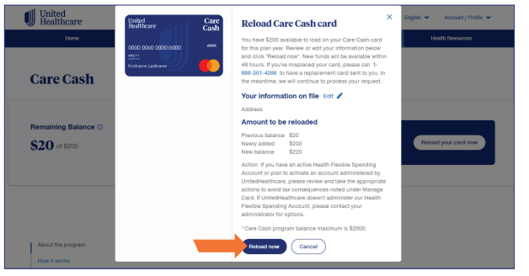
Reload your registered Care Cash card
Follow the prompts to verify your address and contact info or make any required updates. When you’re finished, click the Reload now button.

Slide 22
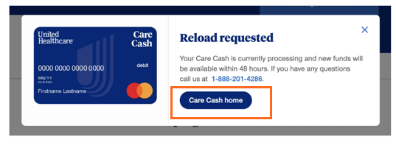
Reload your registered Care Cash card
When you receive the confirmation message, you’ll know your request is complete. Your new balance will be available within 48 hours. You may continue to use your existing card.

Slide 23
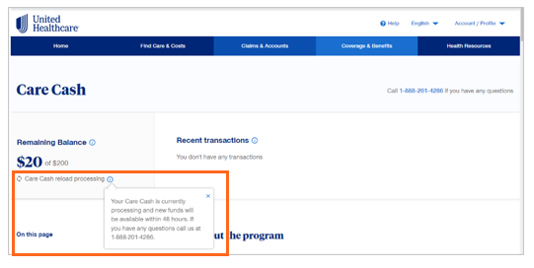
Reload processing confirmation
You will see a confirmation message indicating your request is processing on the myuhc.com/carecash home page under Remaining Balance.

Slide 24
Questions?
Visit myuhc.com/carecash or call the number on your health plan ID card
Care Cash provides a pre-loaded debit card which can be used for certain health care expenses. If the card is used for ineligible 213(d) expenses, individuals may incur tax obligations and should consult an appropriate tax professional to determine if they have such obligations. The information provided in connection with Care Cash is for general informational purposes only and is not intended to be nor should be construed as medical advice. Individuals should consult an appropriate health care professional to determine what may be right for them.
24/7 Virtual Visits is a service available with a provider via video, or audio-only where permitted under state law. It is not an insurance product or a health plan. Unless otherwise required, benefits are available only when services are delivered through a Designated Virtual Network Provider. 24/7 Virtual Visits are not intended to address emergency or life-threatening medical conditions and should not be used in those circumstances. Services may not be available at all times, or in all locations, or for all members. Check your benefit plan to determine if these services are available.
The UnitedHealth Premium® designation program is a resource for informational purposes only. Designations are displayed in UnitedHealthcare online physician directories at myuhc.com®. You should always visit myuhc.com for the most current information. Premium designations are a guide to choosing a physician and may be used as one of many factors you consider when choosing a physician. If you already have a physician, you may also wish to confer with him or her for advice on selecting other physicians. You should also discuss designations with a physician before choosing him or her. Physician evaluations have a risk of error and should not be the sole basis for selecting a physician. Please visit myuhc.com for detailed program information and methodologies.
Employee benefits including group health plan benefits may be taxable benefits unless they fit into specific exception categories. Please consult with your tax specialist to determine taxability of these offerings.
Insurance coverage provided by or through UnitedHealthcare Insurance Company or its affiliates. Administrative services provided by United HealthCare Services, Inc. or their affiliates.

